Slide 1
Roll your own vulnerabilities
@barsteward,
BSides London 2024
An introduction to fault-injection for exploiting bug-free code in embedded systems.
Notes:
Today I’m going to talk about how fault injection attacks can be used to exploit bug free code in embedded systems.
Fault Injection is a local attack on hardware, which requires physical access.
For reasons I’ll cover later, it’s often the foot-in-the-door which can lead to remote attacks later.
This talk is intended as an introduction to the subject, aimed at those with little or no knowledge of FI.
Abstract
Embedded systems are everywhere, automating more and more of our everyday lives. Our cars, phones, games consoles, industrial controllers and IoT devices increasingly require security mechanisms to protect their security configurations, and in some cases, stored secrets, such as cryptographic keys, debug/flash protection access mechanisms, firmware images, and AI models. For a long time, local, physical attacks on general purpose microcontrollers were considered out of scope during threat analysis, but the increase in value of breaking the device security protections, the decrease in cost of the attacks, and the increase in awareness of such attacks, means that we’re in a transitional state regarding protection against fault-injection.
Description
This talk will introduce attendees to fault-injection, a local attack category which is often used as the first step in the attack chain for embedded systems, and in some cases can also lead to remote attacks. It will cover the techniques which attackers use to generate security violations such as bypassing read protection, secure boot, or debug protection in embedded systems, even when the code is completely free of bugs. You will learn about the attacker motivations, tools and techniques, as well as the methods used to harden devices against these attacks, and how increased public awareness, certification, and regulation is changing the landscape. You will see how the cost of the equipment needed is often very low, and learn how you can begin your “glitching” journey for under £20.
We will look at the fault-injection mitigations added in the Raspberry Pi Pico 2, and consider their efficacy - there is currently a $20,000 bug bounty available for breaking these protections leading to recovery of a secret stored in the One-Time-Programmable flash memory.
We shall also touch upon side-channel analysis, which can recover cryptographic keys in use through measurement and analysis of tiny power fluctuations, or even by using a coil to pick up electro-magnetic emanations.
Keywords:
Embedded Systems
Microcontrollers
Hardware Attacks
Fault-Injection
Voltage Fault Injection (VFI)
Electro-Magnetic Faul Injection (EMFI)
Clock Fault Injection (CFI)
Risk Assessment
Threat Modelling
Automotive
Industrial Control Systems
IoT
Mitigation Strategies
Raspberry Pi Pico 2
Side-Channel Analysis

Slide 2
What we’ll cover
Who am I?
What is fault injection?
Types of fault injection attacks
Why/where are fault injection attacks used?
How can fault injection compromise security goals?
Voltage FI Demo / How you can try this yourself
Mitigation techniques & standardisation
Other attacks
Notes:
Today we’ll cover:
Who I am
What fault injection is
Different types of FI attacks
Examples of why and where FI attacks are used
How this can compromise security goals
Live demo
Mitigation techniques
If time, other hardware attacks

Slide 3
What we’ll cover
Who am I?
What is fault injection?
Types of fault injection attacks
Why/where are fault injection attacks used?
How can fault injection compromise security goals?
Voltage FI Demo / How you can try this yourself
Mitigation techniques & standardisation
Other attacks

Slide 4

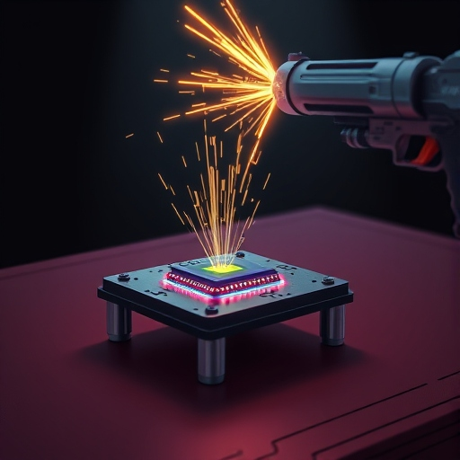
:~$ whoami
@barsteward
Bluesky: @barsteward.bsky.social
Mastodon: @barsteward@infosec.exchange
RIP Twitter: @barsteward
I’m employed to torture silicon chips until they give up their secrets,
or agree that they work for me now.
Hardware penetration testing of claims about
Secure Boot
Flash Read Protection
Debug Protection
(and side-channel analysis resistance)
This talk does not represent the views of my employer!
Notes:
I work for a silicon vendor who sells microcontrollers for use in cars, industrial control systems, IoT devices etc.
My job is focused on hardware penetration testing, to determine whether the microcontrollers we sell are resistant to fault injection and side channel analysis attacks.
Basically, I’m running the internal red team for hardware attacks on our products. My team represents all you hackers out there in the audience; we try to identify vulnerabilities before you lot get a chance to.
In hardware manuals and marketing material, various claims are made about the normal operation of the devices, and it’s my job to try to disprove those claims, so fixes can be made before we release the chip, and to teach others in the organisation about how to protect against attacks on these.
These claims are things like
Secure Boot, where only signed images will be executed
Flash Read Protection, where it should only be possible to read the flash memory contents after authentication, or in certain lifecycle management states
Debug Protection, where debugging should only be possible after authentication, or in certain lifecycle management states
The image is what Deepai.org thinks I do in the lab!
Morph image used under licence: https://creativecommons.org/licenses/by/4.0/
Image source:
Science Museum Group. Model of 'Morph'. 1999-5162 Science Museum Group Collection Online. Accessed 21 November 2024. https://collection.sciencemuseumgroup.org.uk/objects/co8180635/model-of-morph.

Slide 5
What we’ll cover
Who am I?
What is fault injection?
Types of fault injection attacks
Why/where are fault injection attacks used?
How can fault injection compromise security goals?
Voltage FI Demo / How you can try this yourself
Mitigation techniques & standardisation
Other attacks

Slide 6
What The F (I) ?
What is Fault Injection anyway?

Slide 7



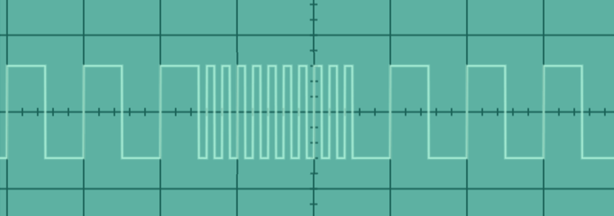

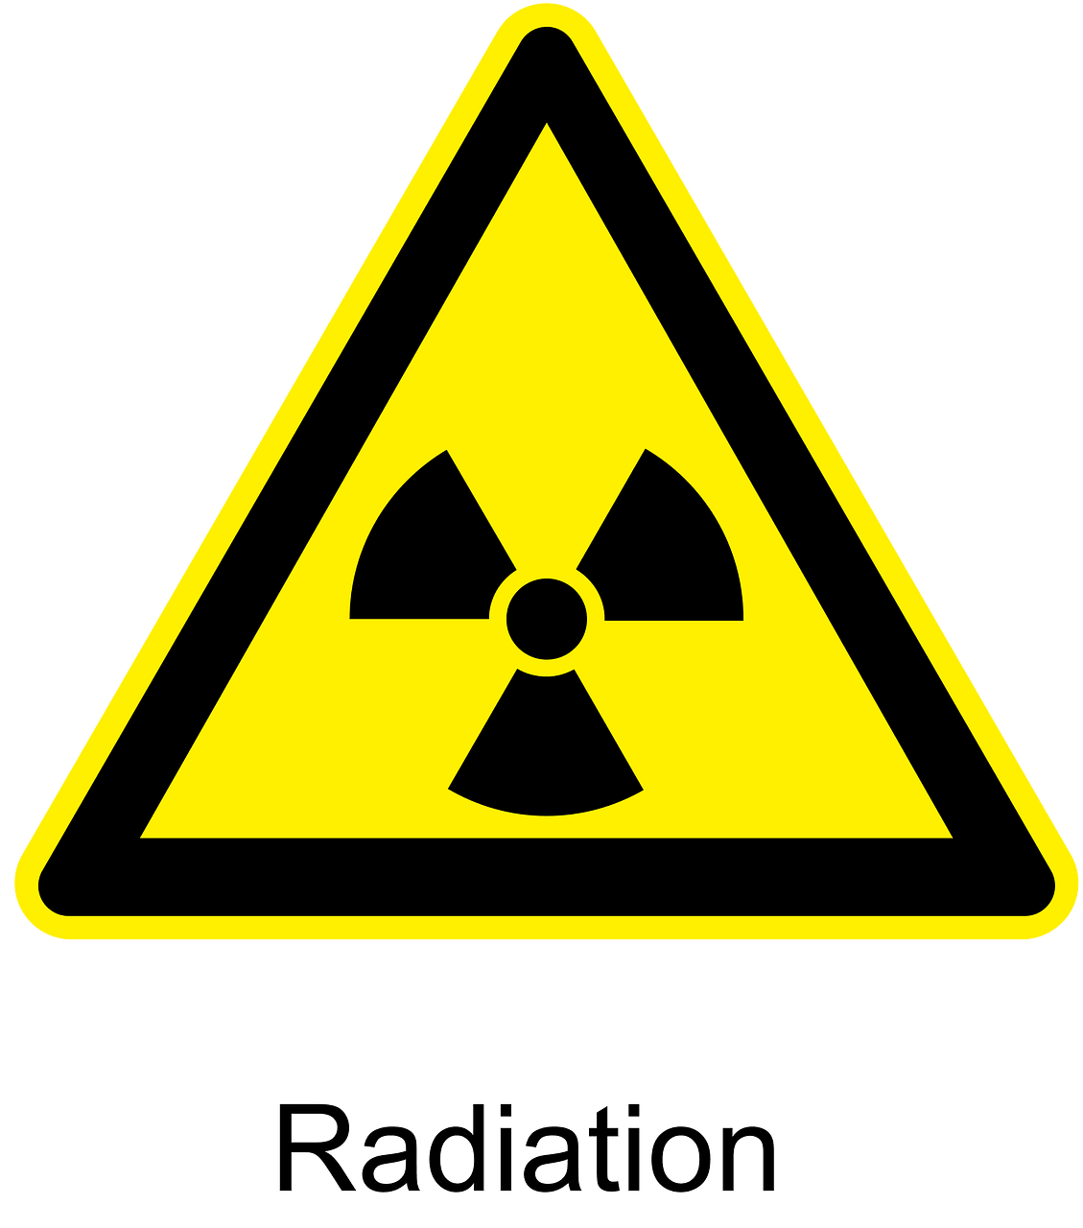
What is Fault Injection (FI)?
Fault Injection (FI) is a class of hardware attacks in which the device is stressed in an unusual way to make it malfunction.
Extremes of
Voltage
Electromagnetic fields
Clock speed
Temperature
Light
Ionizing radiation…
Notes:
Fault Injection (FI) is a class of hardware attacks in which the device is stressed in an unusual way to make it malfunction.
There are many different ways to cause a chip to malfunction; extremes of voltage, electromagnetic fields, clock speeds, temperature, light, ionizing radiation…
***These attacks require physical access to the hardware***
Fault injection is often referred to as “glitching”

Slide 8
What we’ll cover
Who am I?
What is fault injection?
Types of fault injection attacks
Why/where are fault injection attacks used?
How can fault injection compromise security goals?
Voltage FI Demo / How you can try this yourself
Mitigation techniques & standardisation
Other attacks

Slide 9

Voltage Fault Injection (VFI)
Glitches are introduced to the power rails, by briefly changing the supplied voltage, or by driving one or more pins to an incorrect voltage.
Notes:
With Voltage FI, we cause brief “glitches” to the power of the device.
This can be by briefly interrupting the power supply, or applying an incorrect voltage, or shorting a pin.
Sometimes board modifications are needed; for example, removing capacitors can make the device less stable and more vulnerable to glitching.
https://giphy.com/gifs/season-3-the-simpsons-3x24-xT5LMWOExnRmXt2vFS

Slide 10
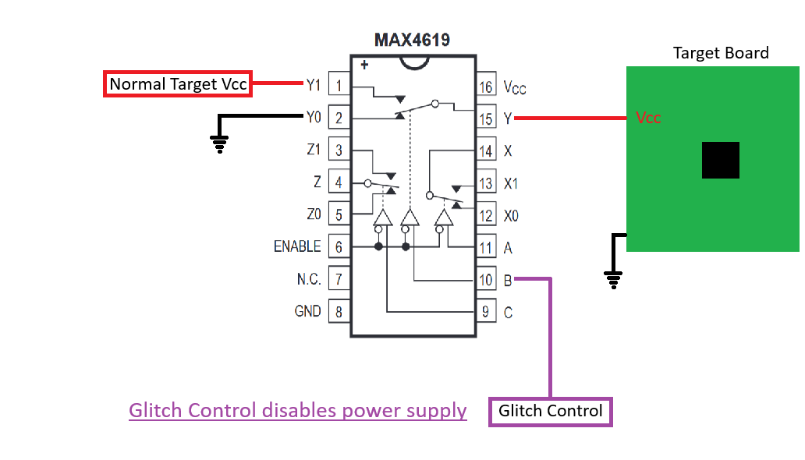
Voltage Fault Injection (VFI)
Glitches are introduced to the power rails, by briefly changing the supplied voltage, or by driving one or more pins to an incorrect voltage.
Notes:
Low entry-level cost – a cheap multiplexer such as the MAX4619 can be used to control the power supplied.

Slide 11
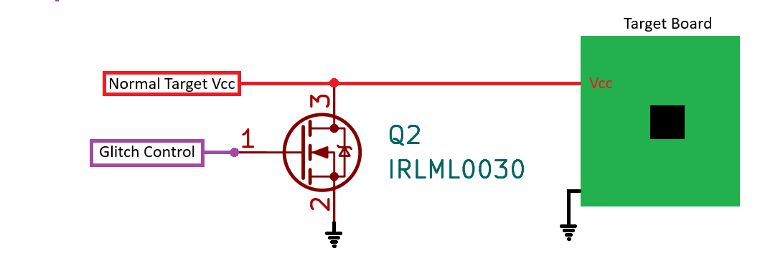
Voltage Fault Injection (VFI)
Glitches are introduced to the power rails, by briefly changing the supplied voltage, or by driving one or more pins to an incorrect voltage.
MOSFET for “crowbar” glitching in contention with power supply
Notes:
Another method is called “Crowbar Glitching”;
Here, the power supply is briefly shorted to ground when the MOSFET transistor is active.

Slide 12
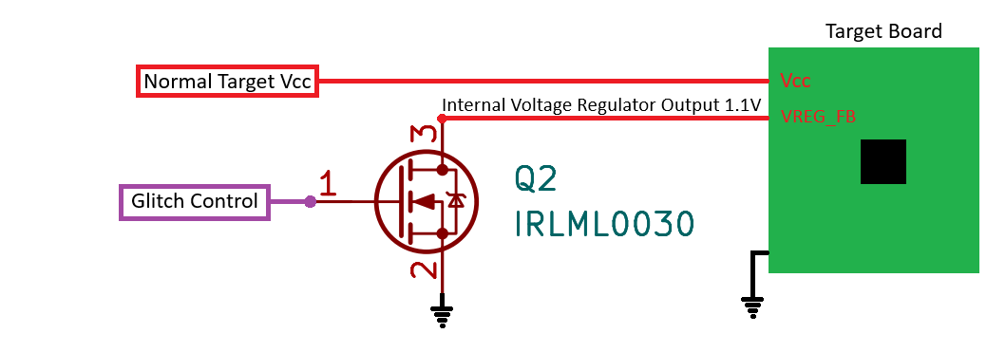
Voltage Fault Injection (VFI)
Glitches are introduced to the power rails, by briefly changing the supplied voltage, or by driving one or more pins to an incorrect voltage.
MOSFET for “crowbar” glitching core voltage rail to Gnd
Notes:
This example shows crowbar glitching the internal regulator output of the chip, rather than the power supply itself, to directly affect the chip’s core CPU voltage.

Slide 13
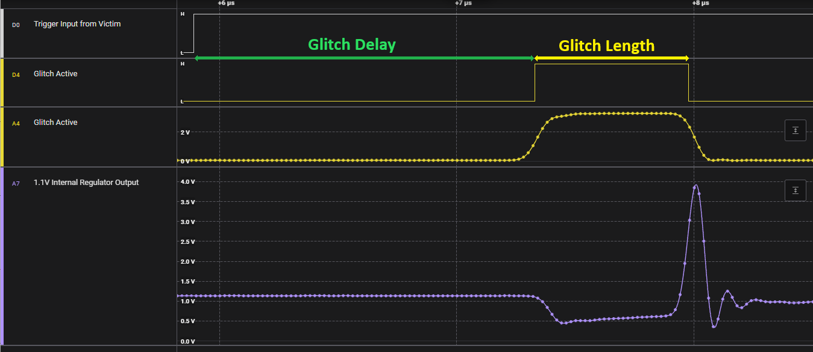
VFI: Glitch Parameters
Notes:
Once wired up, we have two glitch timing parameters to explore;
The glitch delay is the time we should wait after receiving a trigger input, before we activate the glitch
The glitch length is the length of time that the glitch is active for.
By tuning these timings we adjust when and how hard we hit the chip with a glitch.

Slide 14
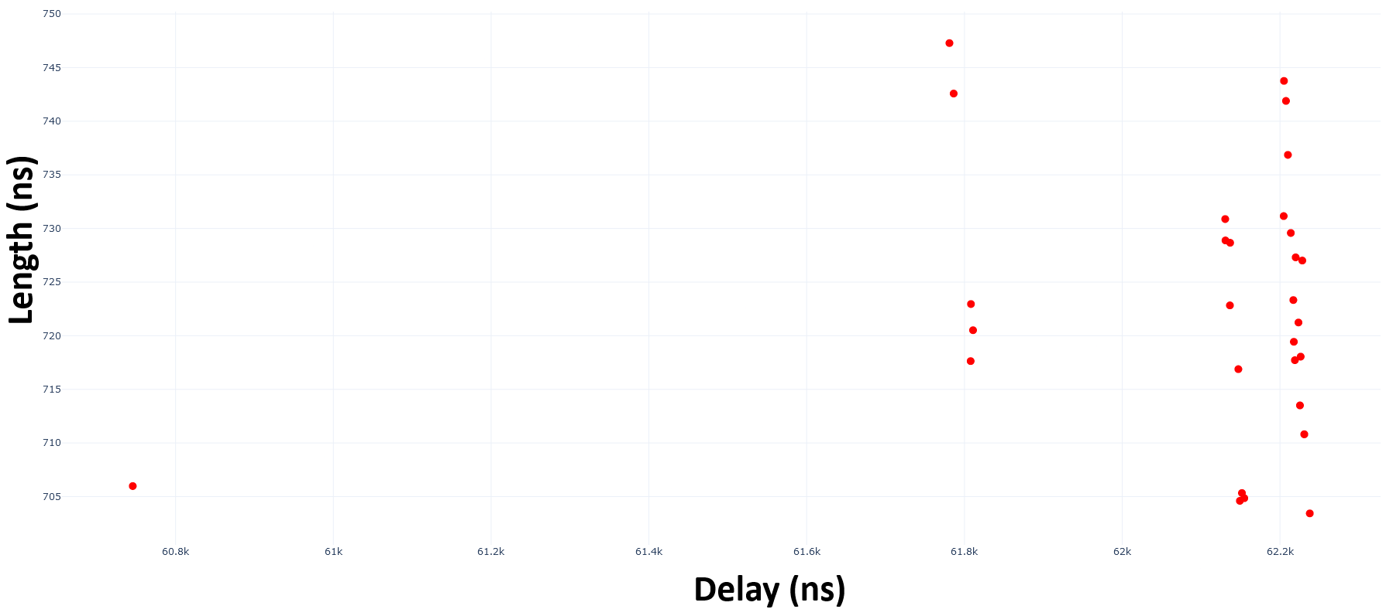
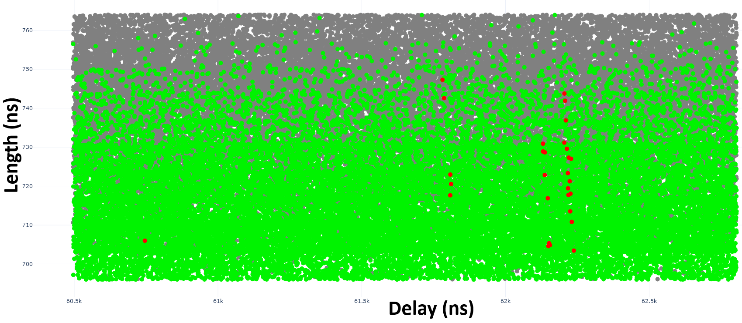
VFI: Glitch Parameter Narrowing
Notes:
It can be tricky to find the “Goldilocks Zone”. This is a plot of results, showing how we search for the right combination of glitch delay and glitch length.
Green represents normal device operation – the chip was unaffected by the glitch
Grey is where the glitch caused the device to stop responding – we hit it too hard
Red is a successful attack
Parameter narrowing is an iterative process which allows us to tune for a higher attack success rate.
These parameters are affected by many things, including board capacitance, length of power wires, thickness and length of glitch wire connection…
@TODO Update image and show just reds

Slide 15
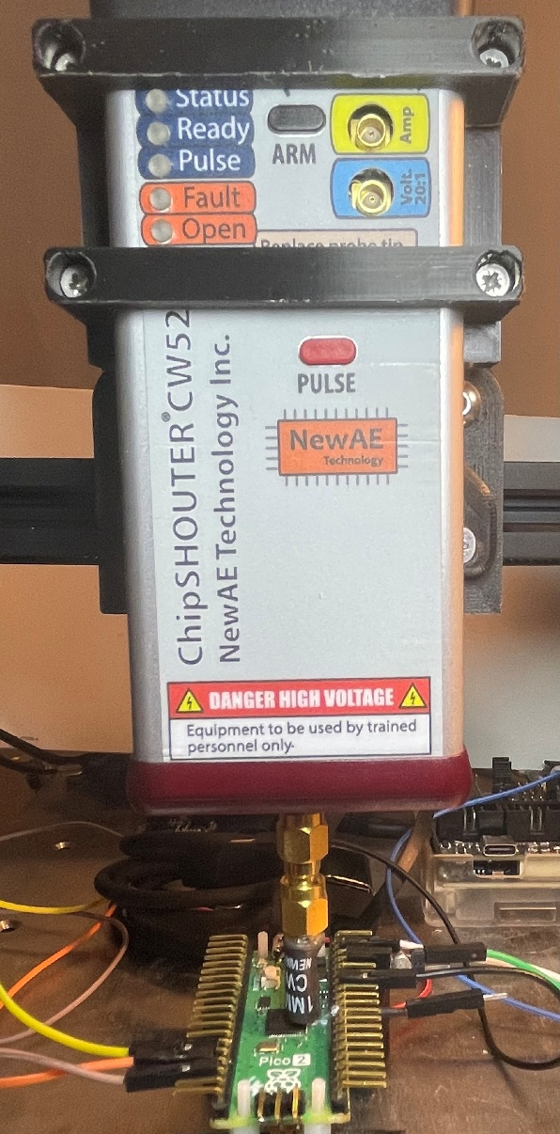
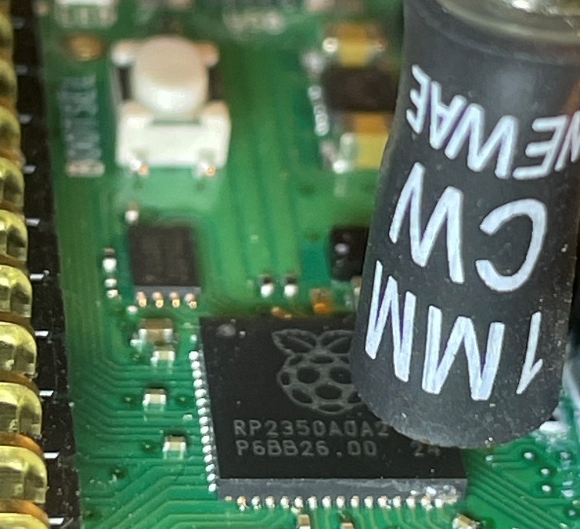
Electro-Magnetic Fault Injection (EMFI)
An EM pulse is delivered from a coil close to the chip
NewAE ChipSHOUTER (CW520)
~£3.5K
Riscure EMFI Transient Probe
*much* more expensive
Homemade circuitry/coil
<£100 but high voltages involved, so not advised!
Generates wide range of glitch effects in target device; a real life “magic wand”:
Corruption of reads/write values, program flow alteration, influencing of compare operations…
occasional release of magic smoke and chip self-destruct!
Notes:
Electro-Magnetic Fault Injection, or EMFI, causes device malfunction by blasting it with a short EM pulse from a coil which is placed near the device.
EMFI is my favourite attack as it requires no board modification, and generates a wide range of effects inside the device.
Effects such as
Corruption of reads/writes,
program flow alteration,
influencing of compare operations…
occasional release of magic smoke and chip self-destruct!
In addition to the delay and length parameters, EMFI also introduces options for the coil voltage (normally 150V – 500V), and positional dependancy of the coil relative to the device
I’m using a cheap (~£250) converted 3D printer (Creality Ender 3) as an XYZ stage for positioning the EMFI probe,
Which is the NewAE ChipSHOUTER (~£3500)
NewAE also sell a kit to make a much cheaper, less powerful version, the PicoEMP, for around £50

Slide 16
What we’ll cover
Who am I?
What is fault injection?
Types of fault injection attacks
Why/where are fault injection attacks used?
How can fault injection compromise security goals?
Voltage FI Demo / How you can try this yourself
Mitigation techniques & standardisation
Other attacks

Slide 17
Why The F (I) ?
Why use Fault Injection anyway?
Notes:
Let’s consider what assets there are to protect in an embedded microcontroller
Intellectual Property
Device firmware
AI models
Trade secrets – undocumented access protocols
Cryptographic keys
Signing keys
Root keys for hardware root of trust – particularly if symmetric
Key installation keys
Backend API keys
Access to hardware/restricted functionality
Avoidance of software limits on features
DRM avoidance
Arbitrary code execution – “modded” firmware
Additionally, obtaining the firmware allows for binary analysis to identify code vulnerabilities, which could lead to a scalable remote attack

Slide 18
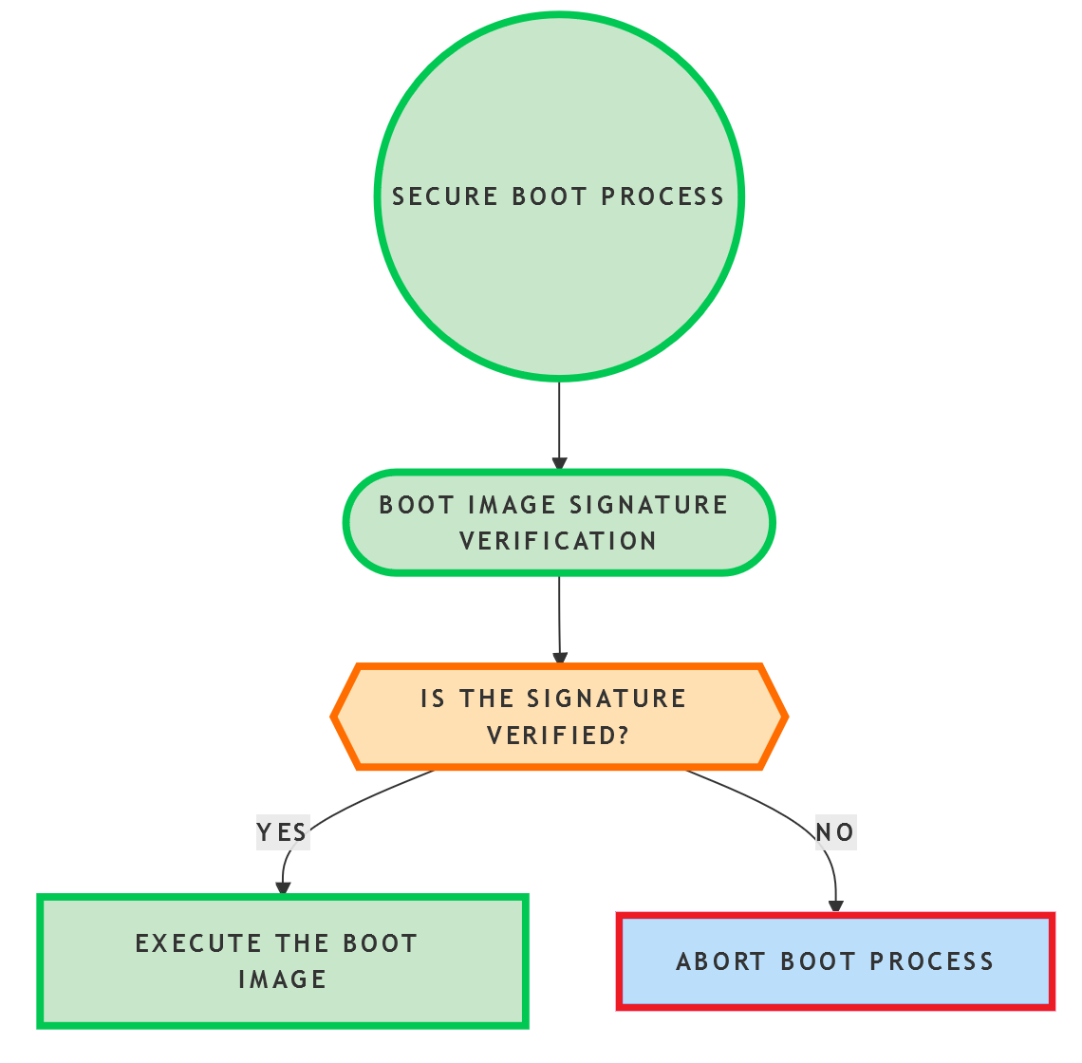

Why an attacker may use fault injection
Secure Boot Bypass
for arbitrary code execution
result = VerifySignature(&image);
if (result == true)
run(&image);
else
Error(“Abort Boot”);
Notes:
Secure Boot Bypass:
It’s great to have a chain of trust from a hardware root key and to use strong cryptography for signature checks, but if you can corrupt the result comparison operation with a fault, then this breaks the chain of trust.
From a manufacturer’s point of view, often the attacker is the owner of the product, looking to bypass restrictions imposed by the manufacturer. Sometimes this is to unlock restricted features, sometimes this is to bypass DRM protections.
Gaining execution can allow an attacker leverage the full device capabilities; this may include use of cryptographic keys for signature generation, so in metering for example, could subvert non-repudiation of electricity / gas readings.
This means that there are often financial motivations for the attacker.

Slide 19

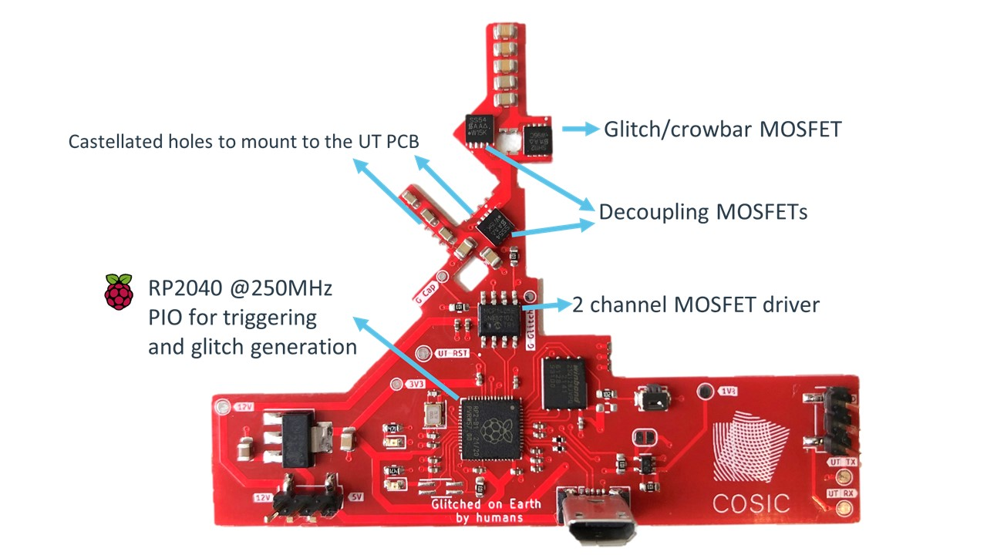
Why an attacker may use fault injection
Secure Boot Bypass
Lennert Wouters: Glitched on Earth by Humans: A Black-Box Security Evaluation of the SpaceX Starlink User Terminal
https://github.com/KULeuven-COSIC/Starlink-FI
https://www.youtube.com/watch?v=NXqLMmGwJm0
Notes:
Lennert Wouters bypassed Secure Boot on the SpaceX Starlink User Terminal using voltage fault injection.
Here we see the modchip PCB which automates this attack, to achieve arbitrary code execution.
Custom quad core ARM Cortex-A53 without documentation or open samples
Lennert Wouters: Glitched on Earth by Humans: A Black-Box Security Evaluation of the SpaceX Starlink User Terminal
https://github.com/KULeuven-COSIC/Starlink-FI
https://www.youtube.com/watch?v=NXqLMmGwJm0
A Bright New Day for Broadband — Starlink (51016637753).jpg
Steve Jurvetson from Los Altos, USA
Creative Commons Attribution 2.0

Slide 20

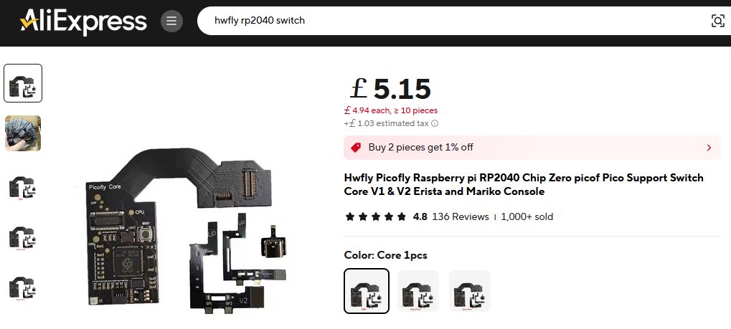
Why an attacker may use fault injection
Secure Boot Bypass
Nintendo Switch modchip for running custom firmware
https://www.retrosix.wiki/picofly-hwfly-rp2040-nintendo-switch
https://www.youtube.com/watch?v=NXqLMmGwJm0
Notes:
Secure Boot Bypass:
Games consoles are often targets for FI; there are also Nintendo Switch modchips commercially available, which use Voltage FI to run custom firmware:
https://www.retrosix.wiki/picofly-hwfly-rp2040-nintendo-switch
https://www.aliexpress.com/item/1005007386986743.html
https://upload.wikimedia.org/wikipedia/commons/7/70/Nintendo_Switch_OLED-Modell_%28BeatEmUps%29_20211001_08.png
https://commons.wikimedia.org/wiki/User:PantheraLeo1359531
This file is licensed under the Creative Commons Attribution 3.0 Unported license:
https://creativecommons.org/licenses/by/3.0/deed.en

Slide 21
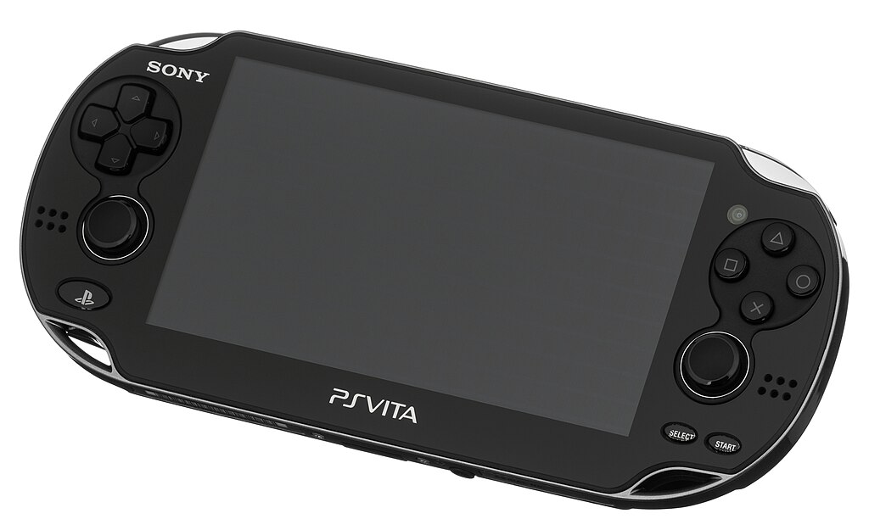
Why an attacker may use fault injection
Read Protection Bypass
Yifan Lu was successful in dumping (reading) the ROM of the Playstation Vita using the NewAE ChipWhisperer to perform voltage fault injection.
Injecting Software Vulnerabilities with Voltage Glitching, Yifan Lu https://arxiv.org/abs/1903.08102
Notes:
Debug / Read Protection Bypass:
In some systems, debug capabilities of the chip are disabled, with the intention of preventing anyone being able to connect with a debugger and read/write memory.
Sony put a lot of effort into trying to protect the PS Vita, after previous failure to protect the PSP / PS3. The PS Vita firmware was dumped through the use of voltage FI. Often FI attacks are foot-in-the-door local physical attack, in order to extract the firmware. This can then be analysed for flaws, which can allow an attacker to pivot to a logical or network attack.
Injecting Software Vulnerabilities with Voltage Glitching, Yifan Lu https://arxiv.org/abs/1903.08102
Image: Public Domain: https://upload.wikimedia.org/wikipedia/commons/thumb/b/b4/PlayStation-Vita-1101-FL.jpg/1024px-PlayStation-Vita-1101-FL.jpg

Slide 22
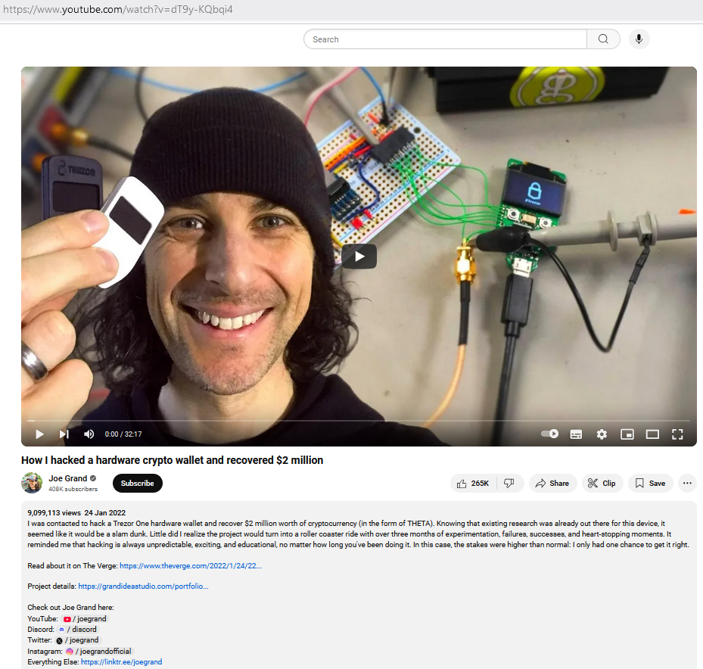
Why an attacker may use fault injection
Read Protection Bypass
Joe Grand recovered $2m of THETA cryptocurrency from a Trezor One hardware wallet, using voltage FI
https://www.youtube.com/watch?v=dT9y-KQbqi4
Notes:
Read Protection Bypass:
There are financial motivations too:
A stored secret in the Trezor One cryptocurrency hardware wallet was recovered by using voltage fault injection to bypass the read protection mechanism.
Joe Grand has a great video showing his attack to recover $2m of THETA when the owner had forgotten his password.

Slide 23
What we’ll cover
Who am I?
What is fault injection?
Types of fault injection attacks
Why/where are fault injection attacks used?
How can fault injection compromise security goals?
Voltage FI Demo / How you can try this yourself
Mitigation techniques & standardisation
Other attacks

Slide 24
How The F (I) ?
How does Fault Injection cause security violations?

Slide 25
How FI affects a device
Affects program flow, security settings and internal variables. Mainly a transient effect, but can lead to permanent data changes too.
Instruction skipping…
Most prevalent effect
Data in flight corruption…
Misread of stored value, address/data bus corruption
Out of order operation…
Read operation may complete early, before data fetch is complete
Op Code Corruption…
Use of incorrect register
The “Jungle Jump” – program counter gets set to incorrect address and execution continues from there!
Notes:
FI generally causes transient faults; brief errors which aren’t permanent, but in some cases, permanent changes can occur.
Affects security settings and internal variables
Instruction skipping – most prevalent effect
Early termination of loops
Skipping of conditional branches
Data in flight corruption – misread of stored value, address/data bus corruption
Use of incorrect data for comparison operations
Out of order operation…
Read operation may complete early, before data fetch is complete
Data corruption
Mainly transient effect, but can lead to permanent data changes too
FI generally causes transient faults; brief errors which aren’t permanent, but in some cases, permanent changes can occur.
Op Code Corruption
A mov data instruction may become a branch instruction
Use of incorrect register
The “Jungle Jump” – program counter gets set to incorrect address and execution continues from there! This effect is by far the hardest to mitigate against.

Slide 26
What we’ll cover
Who am I?
What is fault injection?
Types of fault injection attacks
Why/where are fault injection attacks used?
How can fault injection compromise security goals?
Voltage FI Demo / How you can try this yourself
Mitigation techniques & standardisation
Other attacks

Slide 27

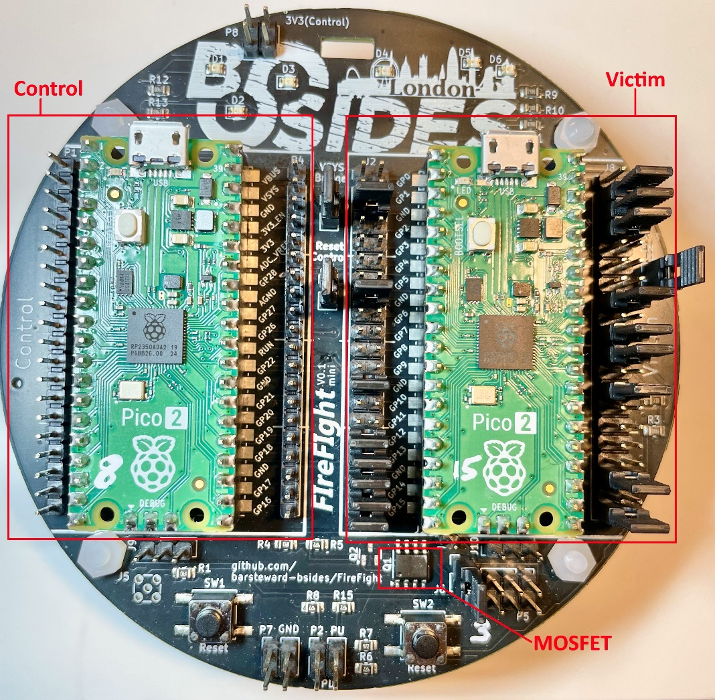
Voltage FI Demo: FIreFIght
This demo will (hopefully!) show a Pi Pico 2 performing voltage glitching on another Pi Pico 2, with the aid of a MOSFET (crowbar glitching the 1.1V internal regulator output)
On the left side we have the “Control” board, and on the right, the “Victim” board.
All PCB gerber/production files and source code for this are available on github: https://github.com/barsteward-bsides/FireFight
(Thanks to AsFaBw for the PCB design work)
Notes:
On to my demo, which I’ve called FIreFIght.
This is a Pi Pico 2 vs another Pi Pico 2:
On the left side we have the “Control” board, and on the right, the “Victim” board.
6 weeks ago this board and this particular demo weren’t planned, and then I heard my talk had been accepted, so a massive thank you to AsFaBw who did all the hard work on the PCB design/layout, whilst I was busy trying to get the code to work!
Each time the Victim board runs, it performs an AES encryption and transmits the ciphertext over UART.
The Control board controls the Victim’s power and RUN line, and using the incredible PIO feature of the Pi Pico2 for timings accurate to 6.66ns, performs the voltage glitch by controlling the MOSFET which briefly shorts the CPU core voltage line to Gnd.
Doing so will occasionally disturb the AES encryption calculation, and *sometimes* causes a very specific type of error.

Slide 28
Voltage FI Demo: FIreFIght
https://github.com/barsteward-bsides/FireFight
Notes:
As a reminder, we have glitch Delay and glitch Length parameters

Slide 29
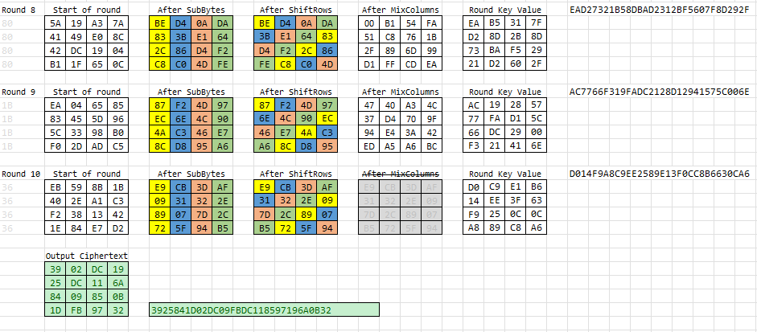
Voltage FI Demo: FIreFIght DFA
Just causing an instruction skip, or a misread didn’t seem to have enough jeopardy for a live conference demo, so instead let’s try something a bit more tricky…
Differential Fault Analysis (DFA) to try to recover the AES key by analysing the faulty ciphertext outputs
Notes:
Instead of a simple “can we cause any error” demo, I’m aiming for something a bit more tricky:
AES Key Recovery using Differential Fault Analysis. This is where we use FI to cause errors in a cryptographic operation, and analyse the output to derive information about the key.
The “Victim” performs an AES 128 encryption and transmits the ciphertext over UART, and the “Control” board performs the voltage glitch by controlling the MOSFET which briefly shorts the CPU core voltage line to Gnd, and collects and analyses the output.
Occasionally we will disturb the AES encryption calculation, and *sometimes*, if the timings are just right, causes a very specific type of error:
We aim to disturb the value of a single byte at the end of Round 8
<reference only – will not speak>
Control board uses the incredible PIO feature of the Pi Pico2 for timings accurate to 6.66ns,
A single byte error in either byte 0, 5, 10, or 15 will cause an error in the ciphertext at bytes 0, 7, 10, and 13
A single byte error in either byte 1, 6, 11, or 12 will cause an error in the ciphertext at bytes 3, 6, 9, and 12
A single byte error in either byte 2, 7, 8, or 13 will cause an error in the ciphertext at bytes 2, 5, 8, and 15
A single byte error in either byte 3, 4, 9, or 14 will cause an error in the ciphertext at bytes 1, 4, 11, and 14

Slide 30
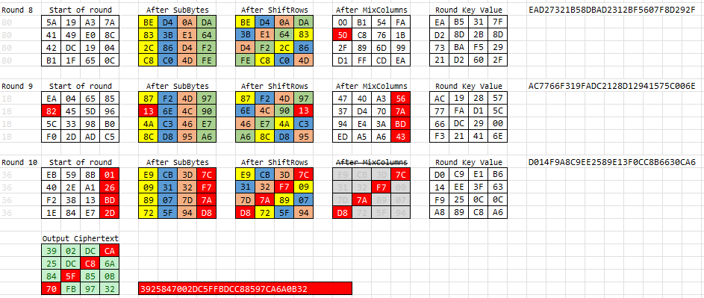
Voltage FI Demo: FIreFIght DFA
Just causing an instruction skip, or a misread didn’t seem to have enough jeopardy for a live conference demo, so instead let’s try something a bit more tricky…
Differential Fault Analysis (DFA) to try to recover the AES key by analysing the faulty ciphertext outputs
Notes:
This will cause a pattern of 4 bytes to be affected in the ciphertext output. There are 4 different groups of these 4 byte patterns that we are interested in - we need at least 2 faulty ciphertexts for each 4 byte group, and the unaffected ciphertext output, to perform key recovery.
<reference only – will not speak>
Control board uses the incredible PIO feature of the Pi Pico2 for timings accurate to 6.66ns,
A single byte error in either byte 0, 5, 10, or 15 will cause an error in the ciphertext at bytes 0, 7, 10, and 13
A single byte error in either byte 1, 6, 11, or 12 will cause an error in the ciphertext at bytes 3, 6, 9, and 12
A single byte error in either byte 2, 7, 8, or 13 will cause an error in the ciphertext at bytes 2, 5, 8, and 15
A single byte error in either byte 3, 4, 9, or 14 will cause an error in the ciphertext at bytes 1, 4, 11, and 14

Slide 31

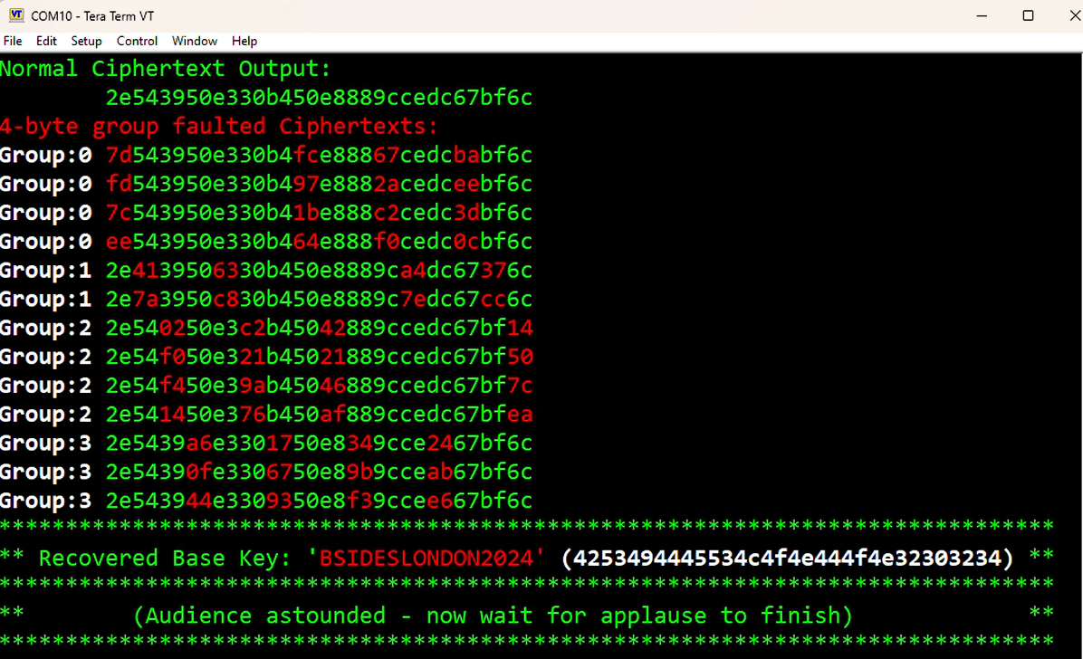
Voltage FI Demo: FIreFIght
Live Demo
This is not a new attack and it heavily relies upon open source libraries such as @Doegox’s PhoenixAES
Notes:
This is not a new attack and it heavily relies upon open source libraries such as @Doegox’s PhoenixAES
I made minor modifications made to PhoenixAES and aeskeyschedule libraries to get them to run in uPython on the Pico 2
Now for the demo…let’s see if we can achieve exactly this effect of corrupting a single byte at the end of round 8 of the encryption…
https://github.com/SideChannelMarvels/JeanGrey/tree/master/phoenixAES

Slide 32
What we’ll cover
Who am I?
What is fault injection?
Types of fault injection attacks
Why/where are fault injection attacks used?
How can fault injection compromise security goals?
Voltage FI Demo / How you can try this yourself
Mitigation techniques & standardisation
Other attacks

Slide 33
Mitigation Techniques
To protect the security goals of a system, numerous mitigation techniques can be employed:
Software hardening techniques
Fail-safe default initialised values
Avoid trivial values for constants such as 0 and 1; maximise hamming distance
Repeated checks for comparisons
Checks that loops completed the correct number of iterations
Randomised timing delays, to make repeatability and attack parameter narrowing harder
Control flow integrity checks
… See Riscure’s “Fault Mitigation Patterns” whitepaper for more details: https://www.riscure.com/publication/fault-mitigation-patterns/
It’s really tricky to write code that will fail safe during a hardware attack
Notes:
Fail-safe default initialised values
Avoid trivial values for constants such as 0 and 1; maximise hamming distance
Repeated checks for comparisons
Checks that loops completed the correct number of iterations
Randomised timing delays, to make repeatability and attack parameter narrowing harder
Control flow integrity checks
Software mitigation patterns is a deep topic. Riscure have a fantastic whitepaper on this, but it does not go into too much depth regarding the cost of implementing these mitigations: https://www.riscure.com/publication/fault-mitigation-patterns/
Cost is a trade-off between code size, performance, and reliability (all of which are important in embedded systems), plus code complexity/maintainability, and development time.

Slide 34
Mitigation Techniques
To protect the security goals of a system, numerous mitigation techniques can be employed:
Hardware techniques
Glitch resistant internal power circuitry
Glitch detectors
Voltage monitoring circuitry
Oscillator disturbance detection
Honeypot logic paths
Memory Protection Units to prevent code execution in restricted areas
Shielding
Control flow integrity mechanisms
Notes:
Hardware mitigations can also be employed
Glitch resistant internal power circuitry
Glitch detectors
Voltage monitoring circuitry
Oscillator disturbance detection
Honeypot logic paths
Memory Protection Units to prevent code execution in restricted areas
Shielding
Control flow integrity mechanisms
Cost is size of additional silicon real estate needed, increase in manufacturing cost, and risk of false positives causing reliability issues

Slide 35
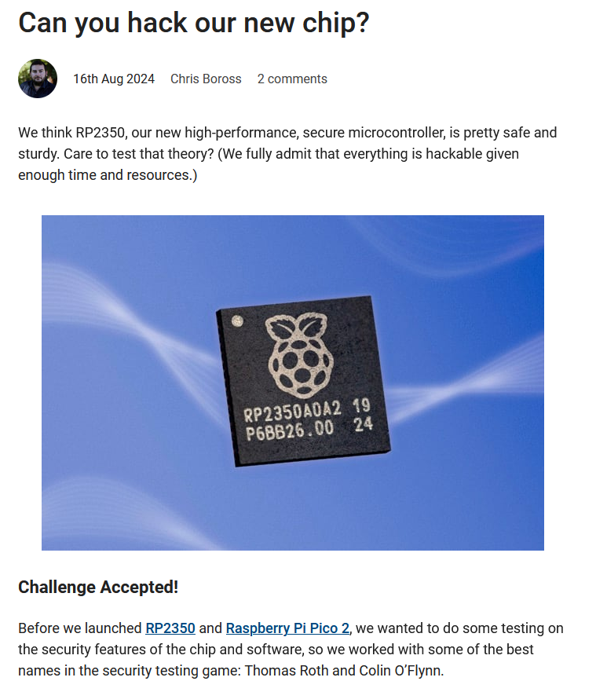
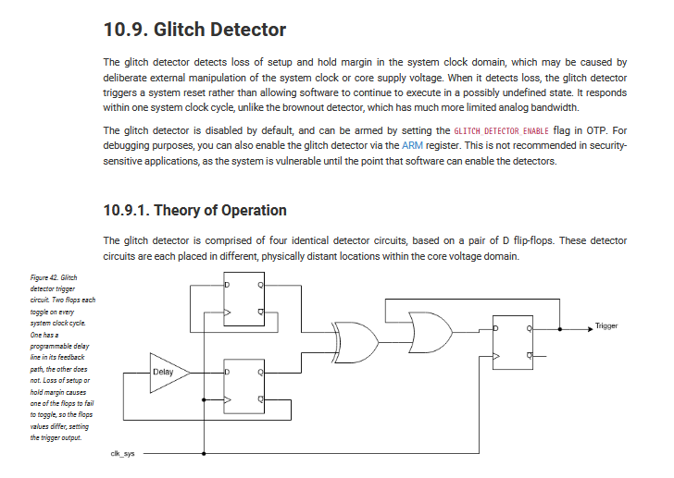
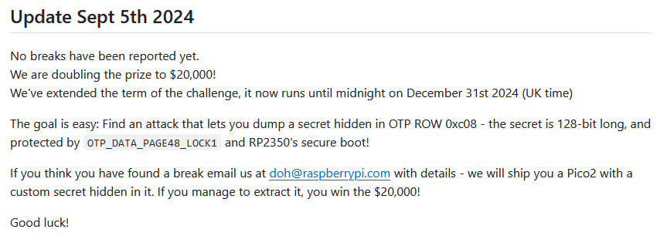
Mitigation Techniques: RP2350 (Raspberry Pi Pico 2)
The RP2350 chip used for the Pi Pico 2 includes a configurable glitch detector, and there’s a $10,000 $20,000 bug bounty for bypassing the chip security features and recovering a secret stored in the OTP flash memory
https://www.raspberrypi.com/news/30000-badges-and-still-no-hack/
https://github.com/raspberrypi/rp2350_hacking_challenge
https://datasheets.raspberrypi.com/rp2350/rp2350-datasheet.pdf
Notes:
Earlier this year the Raspberry Pi RP2350 chip was released (as used on the Pi Pico 2)
This chip includes a variety of fault injection mitigations, and there is a bug bounty for bypassing these chip security features and recovering a secret stored in the OTP flash.
In September they doubled the bounty to $20,000
https://github.com/raspberrypi/rp2350_hacking_challenge
https://datasheets.raspberrypi.com/rp2350/rp2350-datasheet.pdf
https://www.raspberrypi.com/news/30000-badges-and-still-no-hack/

Slide 36
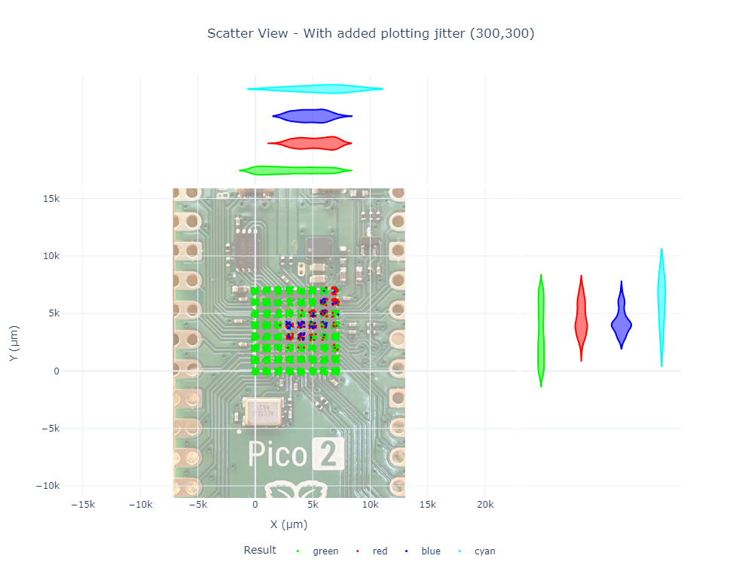
Mitigation Techniques: RP2350 (Raspberry Pi Pico 2)
So how effective is the glitch detector?
This is an EMFI scan I did before enabling the glitch detector, on a simple nested for loop counter…
Red = Successful glitch
Green = Expected response
Blue = Device reboot
Cyan = Corrupted response
Notes:
I took a look at this device to determine how effective the glitch detector is:
This shows the results of an EMFI campaign, against a nested for look counter running on the device. Basically, I was trying to cause it to mis-count.
This was without the glitch detector enabled, as a baseline
Red = Successful glitch
Green = Expected response
Blue = Device reboot
Cyan = Corrupted response

Slide 37
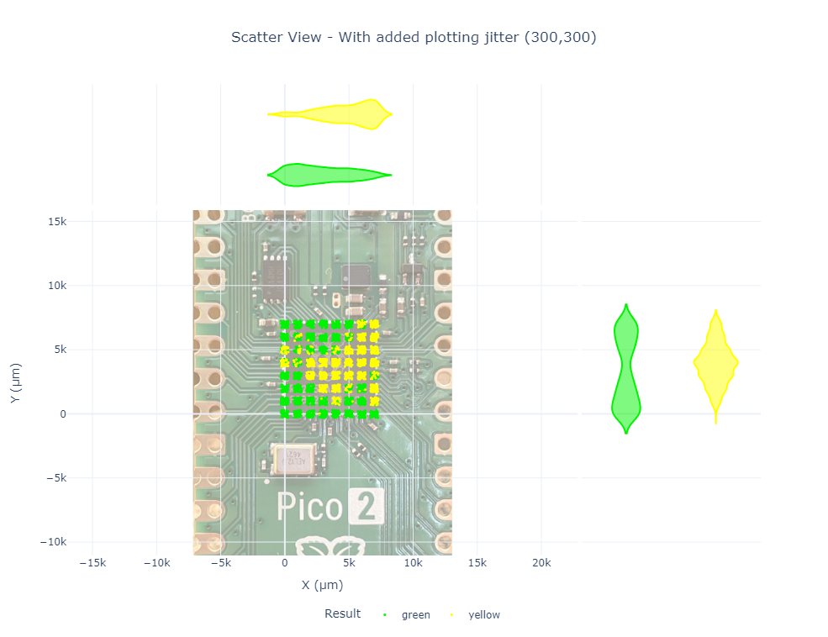
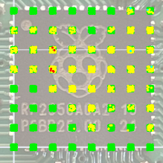
Mitigation Techniques: RP2350 (Raspberry Pi Pico 2)
So how effective is the glitch detector?
And with the glitch detector enabled…
Yellow = Glitch Detected
Green = Expected response
Red = Successful glitch
(1mm Coil, lower power, plus a week of trying)
Notes:
We see that where there were successful glitches, these attempts are now caught by the glitch detector.
But that’s not the end of the story; after a further week of refinement, and using a smaller coil at a lower power,
I was able to corrupt the loop counter without triggering the glitch detector, albeit at a much lower success rate.

Slide 38
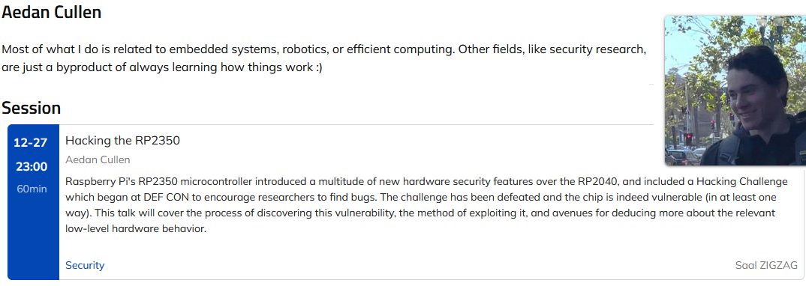
Mitigation Techniques: RP2350 (Raspberry Pi Pico 2)
However… on Dec 27th at 38C3, there’s a talk claiming to have defeated the challenge
https://fahrplan.events.ccc.de/congress/2024/fahrplan/talk/39HFD9/
Notes:
And what looks to be the final chapter of this story is that there’s a talk at 38C3 in a couple of weeks
where Aeden Cullen claims to have successfully defeated the challenge
https://fahrplan.events.ccc.de/congress/2024/fahrplan/talk/39HFD9/

Slide 39





Standards and certifications
Standards and certification schemes are influencing things:
Common Criteria (ISO/IEC 15408:2022) is the certification standard for Smart Cards and high security devices, but this is very expensive to comply with.
NIST FIPS 140-3
Automotive standard ISO/SAE 21434:2021 has forced automotive manufacturers to consider these types of attacks
Certification schemes such as ARM PSA and SESIP have a number of levels, some of which require resistance to FI attacks
The EU Cyber Resilience Act will enforce strict incident reporting rules, which may also influence product security decisions.
Notes:
There are a number of standards and certification schemes which are influencing FI resistance:
Common Criteria is the certification standard for Smart Cards and high security devices, but this is very expensive to comply with, well into 6 figures.
For cryptographic modules, NIST have the FIPS 140-3 scheme
For automotive use, ISO/SAE 21434 has forced all levels of the supply chain from OEMs to Tier 2 suppliers to consider FI attacks in their threat modelling
Other certification schemes available (mainly used for using security as a distinguisher from the competition):
ARM PSA and SESIP, both have a number of security levels, with FI testing included in the higher levels.
The EU Cyber Resilience Act will also mandate product vulnerability reporting, so this may influence security decisions made during development.
CC ISO/IEC 15408:2022: https://www.iso.org/standard/72891.html
FIPS 140-3: https://csrc.nist.gov/pubs/fips/140-3/final
PSA Certified: https://www.psacertified.org/
SESIP: https://www.trustcb.com/iot/sesip/
ISO/SAE 21434:2021: https://www.iso.org/standard/70918.html
CRA: https://www.european-cyber-resilience-act.com/

Slide 40
What we’ll cover
Who am I?
What is fault injection?
Types of fault injection attacks
Why/where are fault injection attacks used?
How can fault injection compromise security goals?
Voltage FI Demo / How you can try this yourself
Mitigation techniques & standardisation
Other attacks

Slide 41
Invasive attacks(if time!)
Decapsulation and optical read of ROM
Micro-probing to connect to internal signals or to connect/disconnect internal lines
Body Bias Injection: voltage glitch to the ground plane inside the chip – this raises the Gnd voltage and can cause localised data misreads due to the reduced potential difference between Gnd and core voltage.
Notes:
There are other methods, often more invasive, to recover device secrets,
Decapsulation and optical read of ROM
Micro-probing to connect to internal signals or to connect/disconnect internal lines
Body Bias Injection: voltage glitch to the ground plane inside the chip – this raises the Gnd voltage and can cause localised data misreads due to the reduced potential difference between Gnd and core voltage.

Slide 42
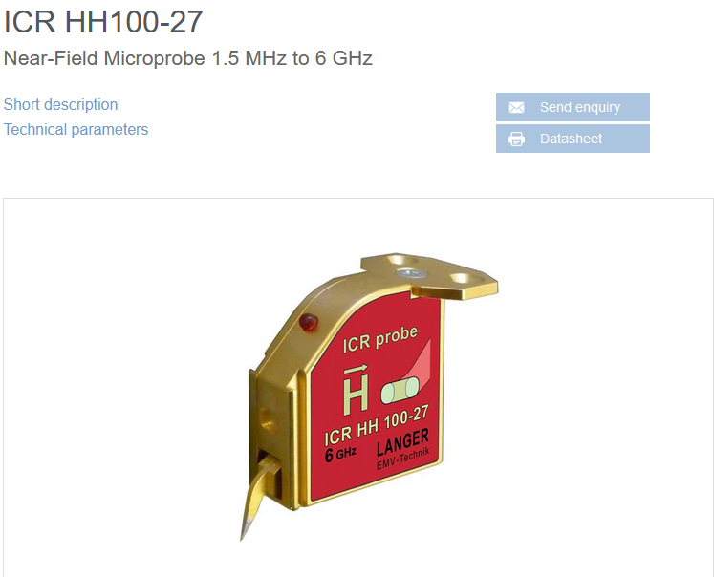
Side Channel Analysis (if time!)
Detection of tiny data dependant fluctuations in timing, power or electromagnetic emissions.
It can be possible to fully recover a cryptographic key that’s in use, by capturing and analysing the EM emmissions from the chip, by placing a near-field microprobe close to the chip surface.
https://www.langer-emv.de/en/product/near-field-microprobe-sets-icr-hh-h-field/26/icr-hh100-27-set-near-field-microprobe-1-5-mhz-6-ghz/768/icr-hh100-27-near-field-microprobe-1-5-mhz-to-6-ghz/101
Notes:
And side-channel analysis can use tiny data dependant fluctuations in timing, power or electromagnetic emissions to recover cryptographic keys.
SCA can also be useful for fault injection, when used to trigger the glitch, or in timing analysis during parameter refinement.

Slide 43
Conclusions
It’s hard (and costly) to protect against physical attacks on hardware if people can get access to the chip.
These attacks are becoming more widely known/exploited and the tools are getting cheaper.
Glitch detectors (and other mitigations) can make a huge difference to the difficulty and repeatability of a fault injection attack, but they’re not perfect.
There is more effort going into hardware and software protection mechanisms now too.
System design that avoids storage of secrets is a great defence, but not always practical
Notes:
It’s hard (and costly) to protect against physical attacks on hardware if people can get access to the chip.
These attacks are becoming more widely known/exploited and the tools are getting cheaper.
Glitch detectors (and other mitigations) can make a huge difference to the difficulty and repeatability of a fault injection attack, but they’re not perfect.
There is more effort going into hardware and software protection mechanisms now too.
System design that avoids storage of secrets is a great defence, but not always practical

Slide 44
Code Credit
FIreFIght control interface, including PIO glitch control: @barsteward
https://github.com/barsteward-bsides/FireFight
DFA Key recovery library phoenixAES: Philippe Teuwen @doegox
https://github.com/SideChannelMarvels/JeanGrey/tree/master/phoenixAES
AES key schedule library aeskeyschedule: Marcel Nageler @fanoster
https://github.com/fanosta/aeskeyschedule
Other Credits
PCB Design: AsFaBw https://github.com/AsFaBw
ChipSHOUTER EMFI probe: Colin O’Flynn @oflynn.com (NewAE)
https://www.newae.com/ (Check out the ChipWhisperer too)
Incredible patience: My wife
Fortunately, no link!

Slide 45
Image Credits
Morph image used under licence: https://creativecommons.org/licenses/by/4.0/ Science Museum Group. Model of 'Morph'. 1999-5162 Science Museum Group Collection Online. https://collection.sciencemuseumgroup.org.uk/objects/co8180635/model-of-morph
AI image of chip torture https://deepai.org/
Homer Simpson light switch https://giphy.com/gifs/season-3-the-simpsons-3x24-xT5LMWOExnRmXt2vFS
MAX4619 image under fair usage from https://www.analog.com/media/en/technical-documentation/data-sheets/MAX4617-MAX4619.pdf
Starlink Dish image https://commons.wikimedia.org/wiki/File:A_Bright_New_Day_for_Broadband_%E2%80%94_Starlink_(51016637753).jpg Steve Jurvetson from Los Altos, USA, Creative Commons Attribution 2.0
Starlink Modchip image used with permission from Lennert Wouters modchip.jpg: https://github.com/KULeuven-COSIC/Starlink-FI
Joe Grand screenshot from YouTube used under fair usage https://www.youtube.com/watch?v=dT9y-KQbqi4
Nintendo Switch image by PantheraLeo1359531: https://upload.wikimedia.org/wikipedia/commons/7/70/Nintendo_Switch_OLED-Modell_%28BeatEmUps%29_20211001_08.png Licensed under the Creative Commons Attribution 3.0 Unported license
All other images and clipart unrestricted or included under fair usage

Slide 46
So long and thanks for all the fish
These slides, along with the FIreFIght PCB design files, and the embedded FIreFIght code for the DFA demo are available at:
https://github.com/barsteward-bsides/FireFight
(Definitely not a Rick-Roll)
This presentation copyright @barsteward 2024
Released under CC BY 4.0
https://creativecommons.org/licenses/by/4.0/
Bluesky: @barsteward.bsky.social
Mastodon: @barsteward@infosec.exchange
RIP Twitter: @barsteward

